Slide 1
Surface Area of a Hand
By Katie Corry in collaboration with Dr. Hoegler

Slide 2
Thesis
Does the finding the surface area of an individual’s hand change the way we look at the Rule of Nines?

Slide 3
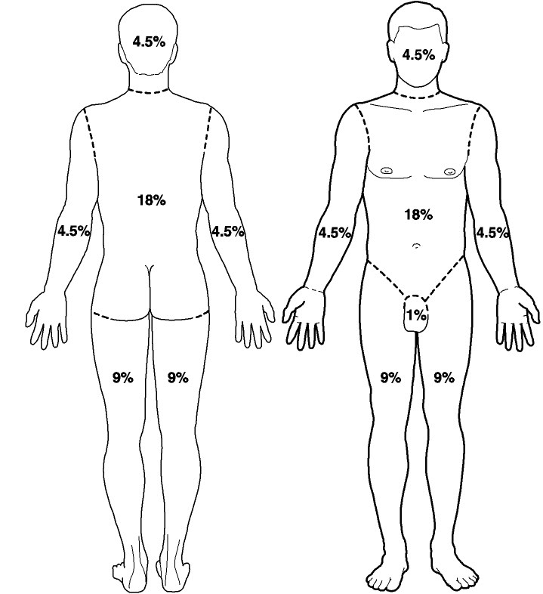
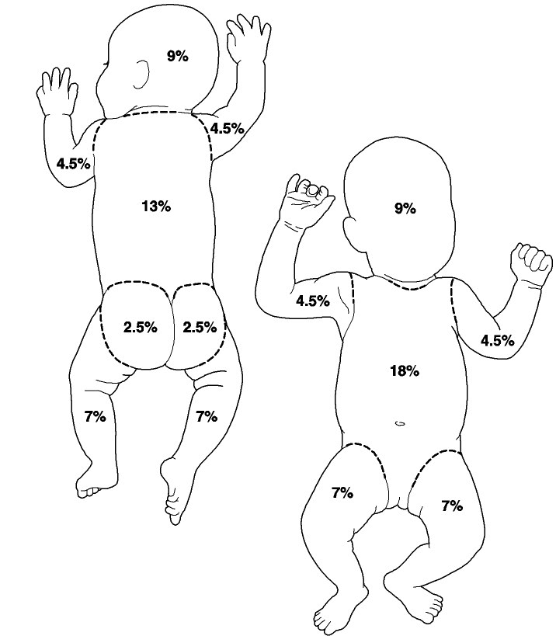
Rule of Nines and Burn Victims

Slide 4
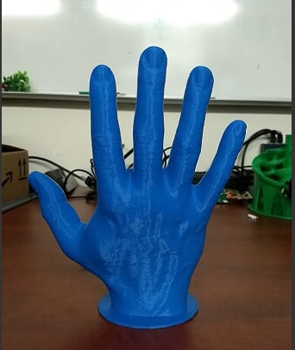
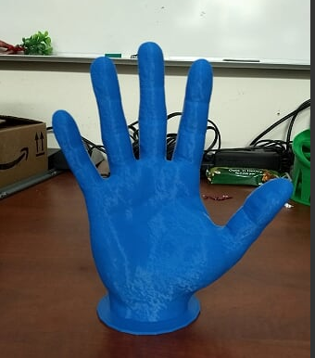
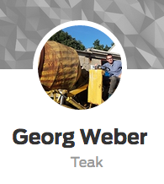
3-D Hand

Slide 5
Factors to consider:
Gender
Age
Weight
Height
Job

Slide 6
Measurement Techniques
Direct coating
Triangulation
Geometrically
Linearly
Surface Integration

Slide 7
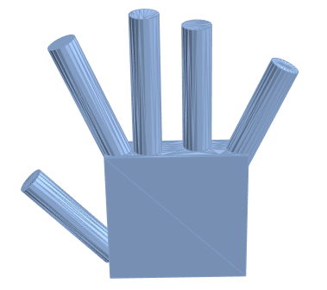
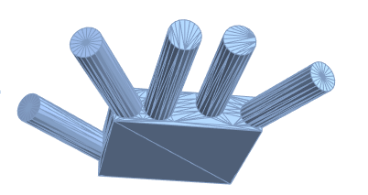
Geometrically
Cylinder | Radius (in) | Height (in) | Surface Area
Pointer | .25 in | 2.80 in | 4.79 sq. inches
Middle | .25 in | 3.00 in | 5.11 sq. inches
Ring | .20 in | 2.75 in | 3.71 sq. inches
Pinky | .15 in | 2.50 in | 2.50 sq. inches
Thumb | .25 I n | 2.50 in | 4.32 sq. inches
Square (edge in inches) | Surface Area
A = 1 in, B = 3 in, C =2.80 in | 28.4 sq. inches
Surface area of a cube:
A= 2ab + 2bc + 2ac
Surface area of cylinder:
A=2$Π$r²+2$Π$rh
Total Surface Area of left hand:
48.83 sq. inches

Slide 8
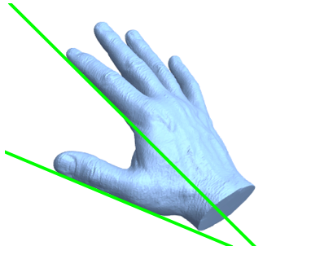
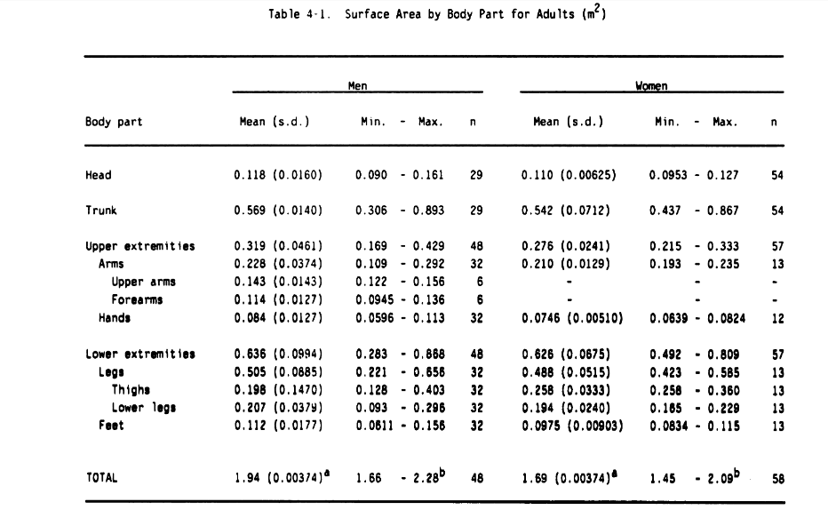
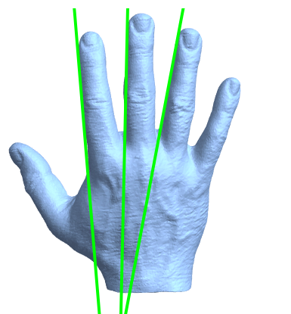
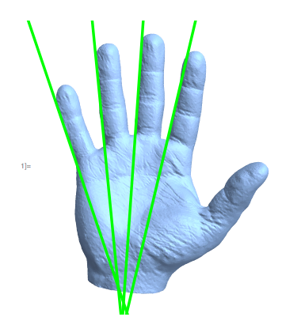
Linearly

Slide 9
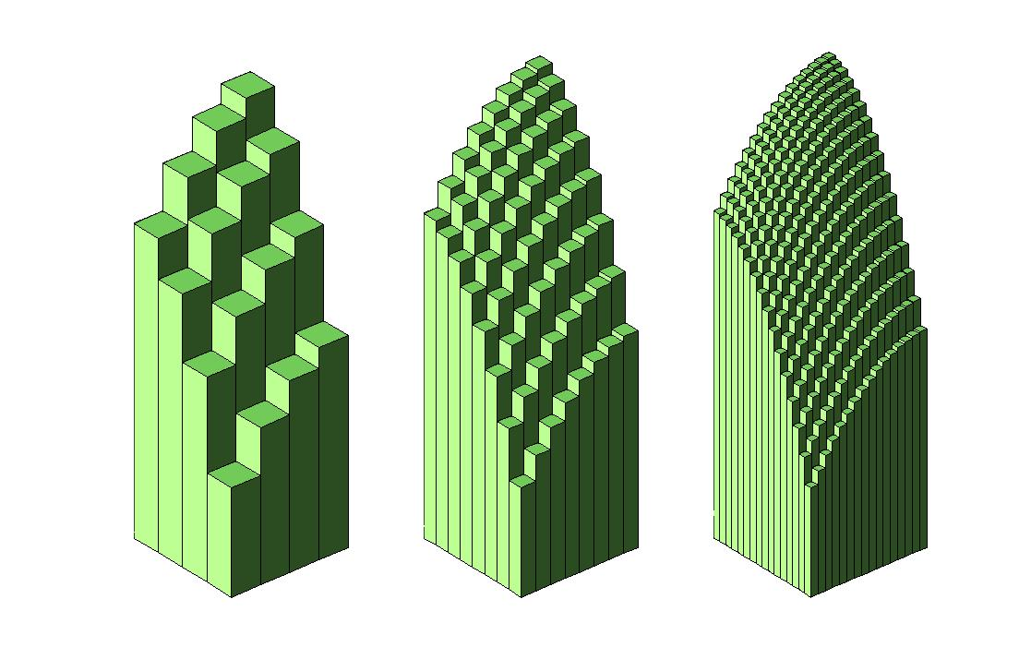
Surface Integration
Surface integration involves integrating a function over some surface in 3D space.

Slide 10
3D Printed Skin
http://www.cbsnews.com/news/how-3d-printing-could-revolutionize-burn-treatment/

Slide 11
Questions/Comments

